Slide 1
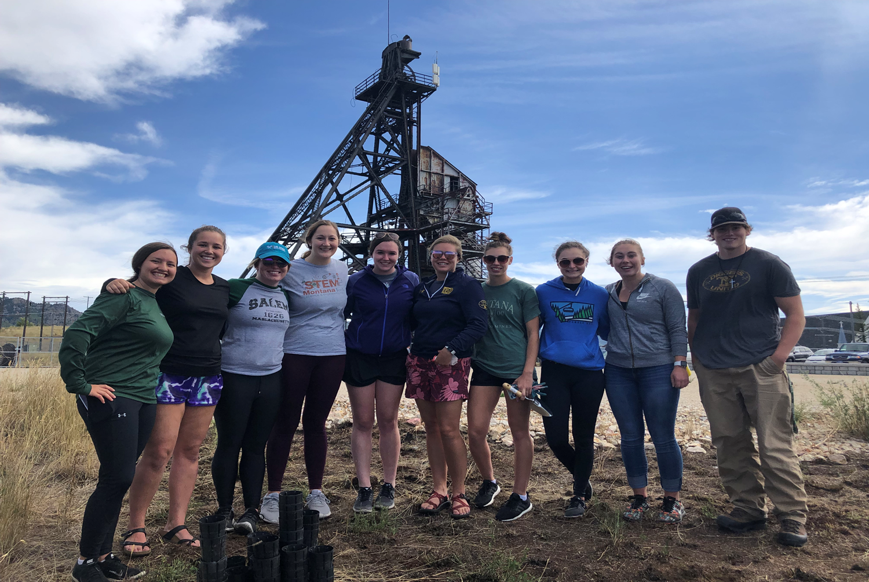
Advancing Montana Tech
October 5, 2019

Slide 2
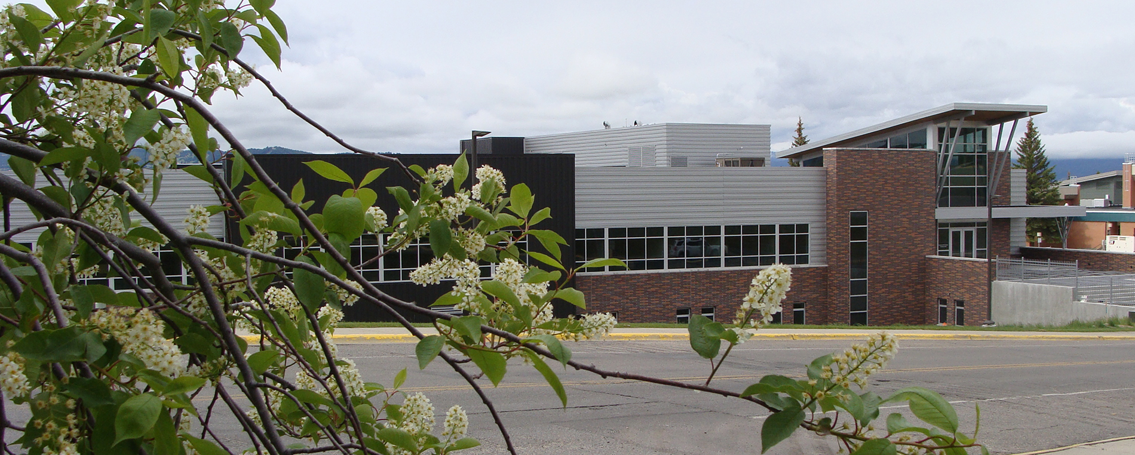
VISION
Recruitment/enrollment
Student success
Telling our story
Positioning ourselves for the future

Slide 3

Topics
Enrollment- Dr. Carrie Vath
Finance- Carleen Cassidy
Advancement- Joe McClafferty

Slide 4

Enrollment Landscape

Slide 5

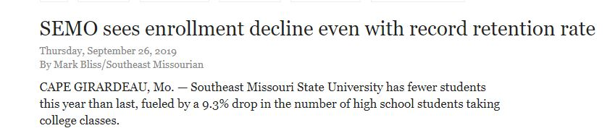
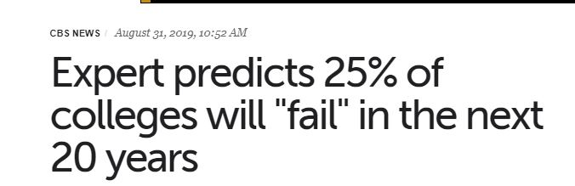




Slide 6

Projected change in high school graduates
Public and non-public, 2019-20 to 2029-30
© Copyright 2016. Knocking at the College Door.
Western Interstate Commission for Higher Education

Slide 7
Projected number of high school graduates
Montana 2013-32
School Year | Public Schools | Hispanic | White | Black | Amer Ind/AK Nat | Asian Pac-Isl
2019-20 | 9,494 | 466 | 8,010 | 83 | 814 | 111
2024-25 | 10,174 | 794 | 8,592 | 56 | 811 | 76
2029-30 | 9,907 | 876 | 8,362 | 86 | 730 | 108
5 yr Change | 7.2% | 70.6% | 7.3% | -31.8% | -0.3% | -31.4%
10 yr Change | 4.4% | 88.1% | 4.4% | 4.0% | -10.3% | -2.8%
© Copyright 2016. Knocking at the College Door.
Western Interstate Commission for Higher Education

Slide 9
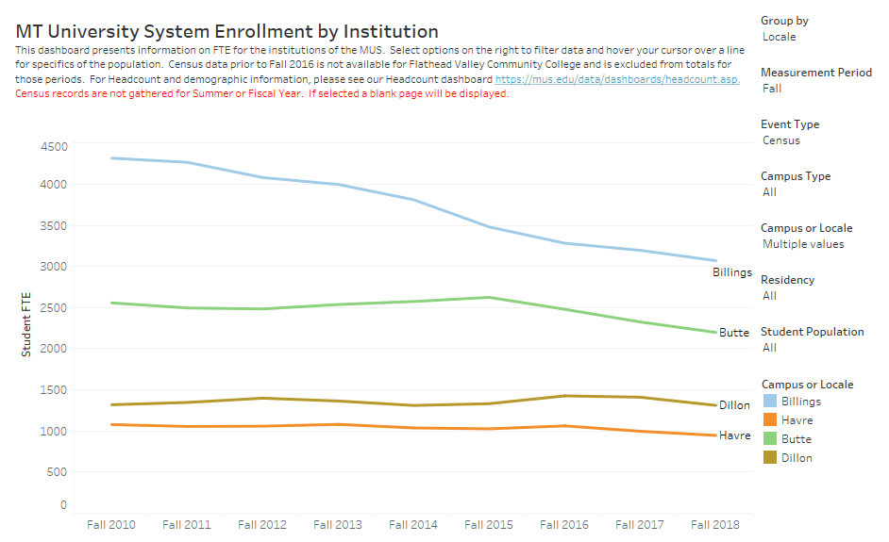

Slide 10
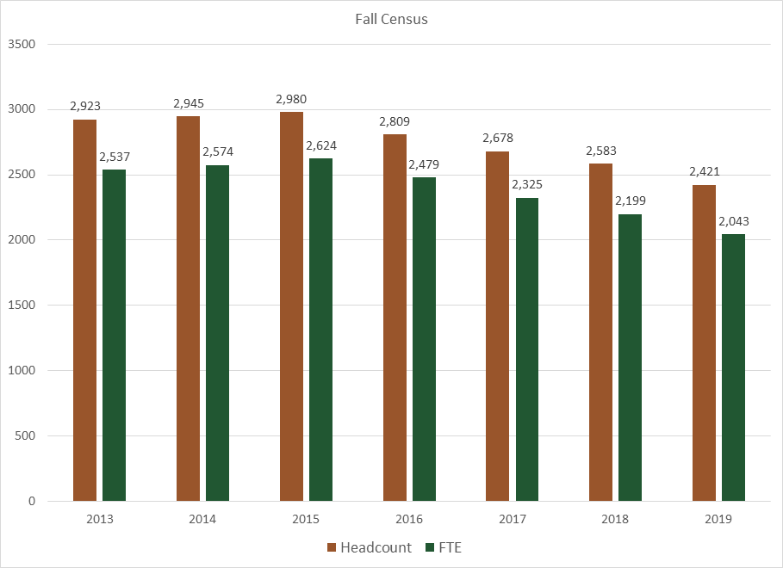

Slide 11
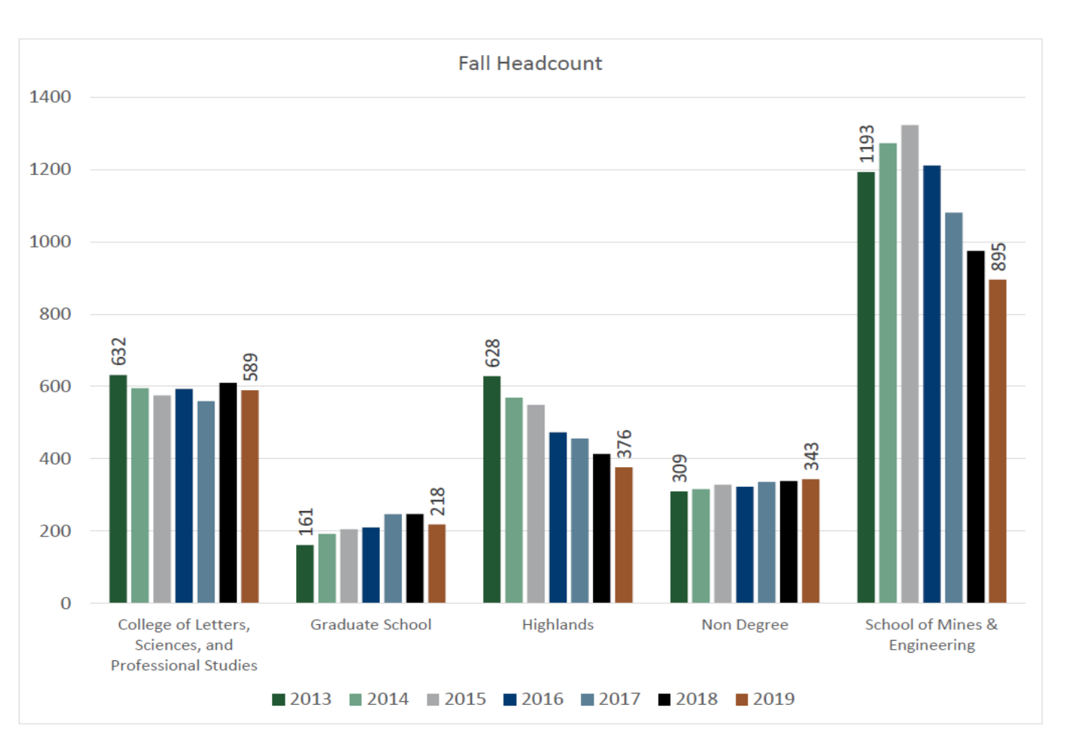

Slide 12



Increase MT HS Capture Rate by 1% on each campus
Increase out of State students
(Consistently 70/30)
Increase Transfer Students
(Historically have been International)
Increase Retention and Graduation Rate (Goal=North 80/60, Current 73/45; South 58/22, Current= 54/17)
HS #’s Nationally
& in Montana
ATTRITION
International Students
Incoming
Continuing
Enrollment
Graduates
Students
Transferring
Transfer Students
Life
Academic
Standing
~400* per year
Loose ~ 200* per year
Loose ~ 400* per year
*Not real value but estimate to illustrate a point
Notes:
80/60 and 58/22 is based on ACT section level: North campus = Selective 21-26; South campus = Open 16-22,

Slide 13
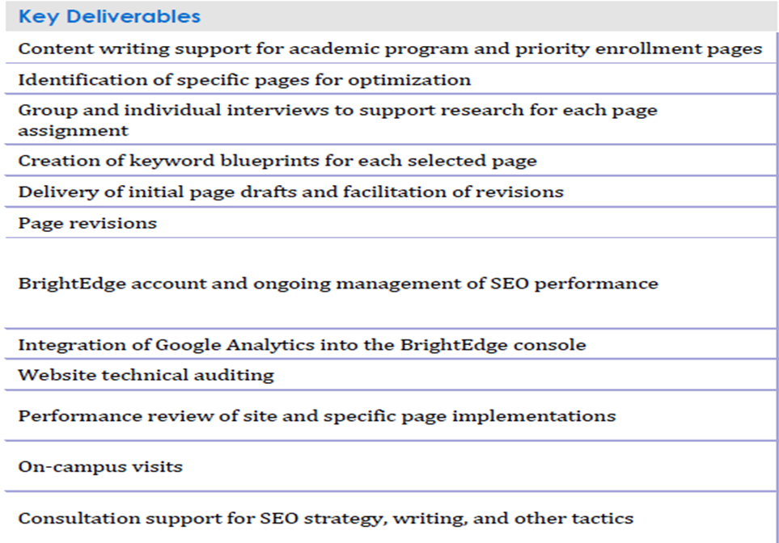
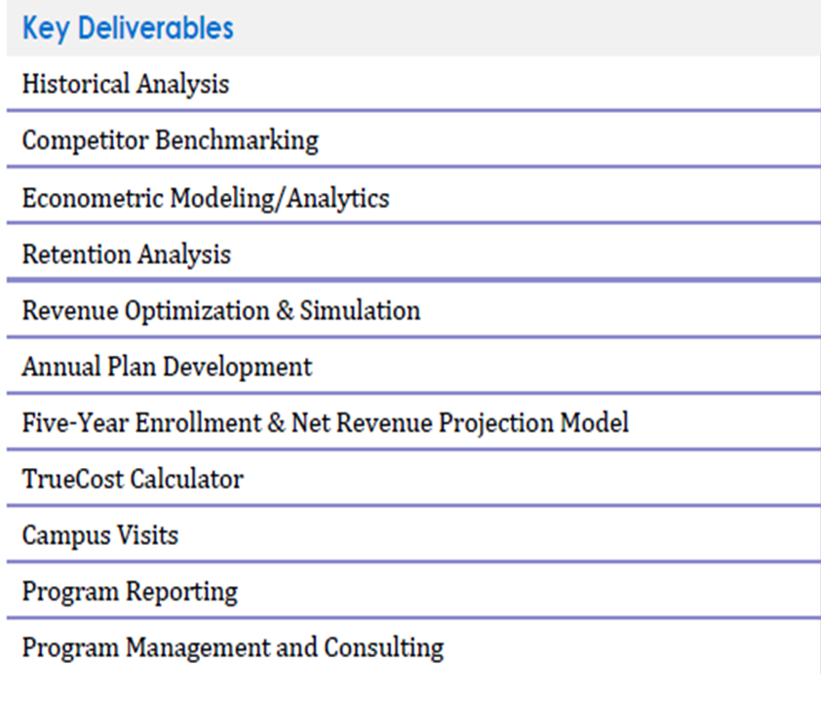
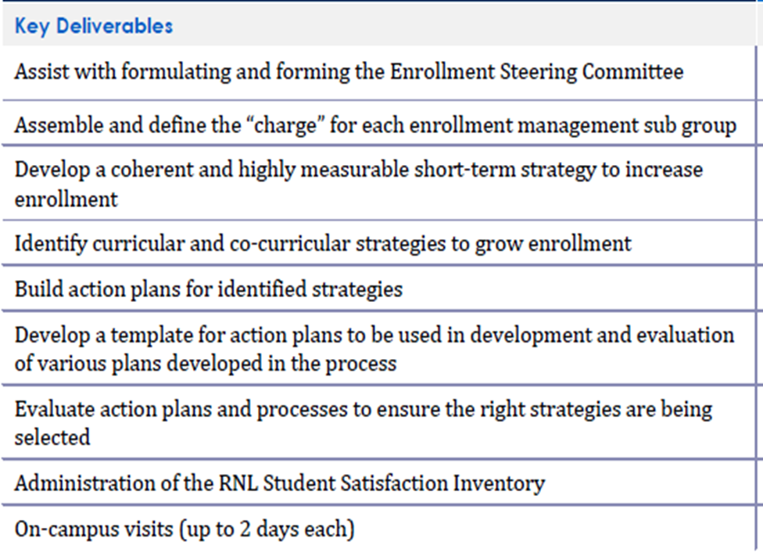
Ruffallo-Noel Levitz partnership
Search Engine Optimization
Financial Aid Optimization
Enrollment Recovery Plan

Slide 14

Finance

Slide 15
© Copyright 2016. Knocking at the College Door.
Western Interstate Commission for Higher Education

Slide 16
© Copyright 2016. Knocking at the College Door.
Western Interstate Commission for Higher Education

Slide 17

Advancement

Slide 18

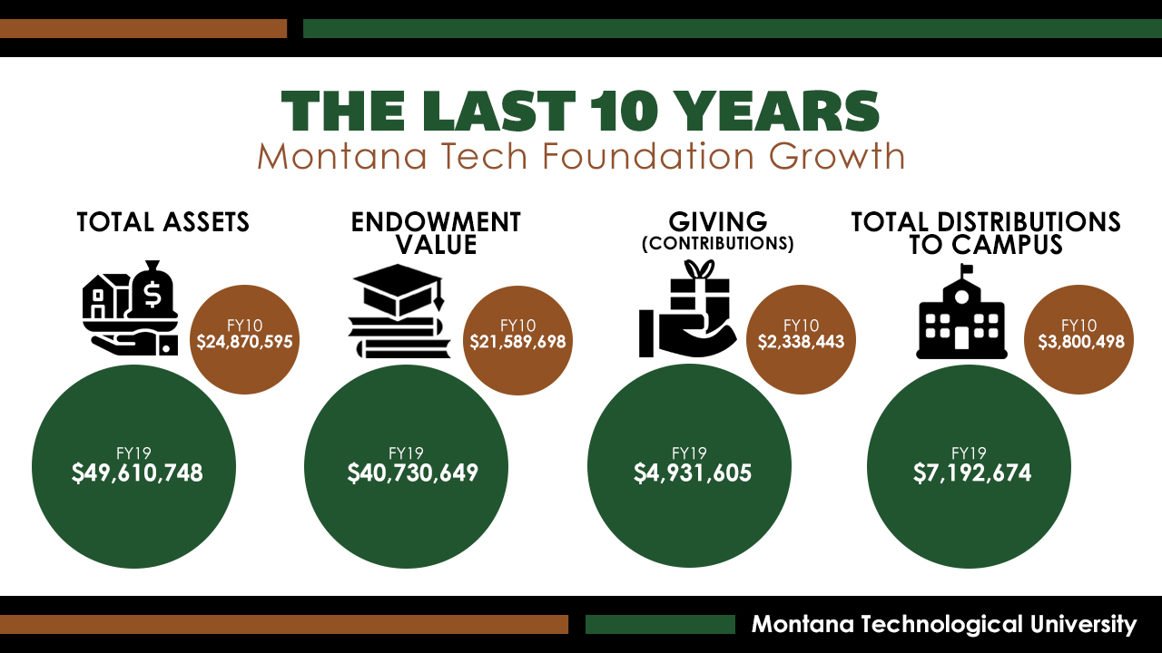
Ten Year Comparison 3 graphs

Slide 19
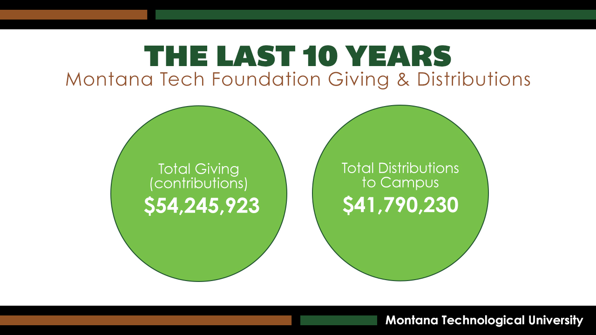

Slide 20
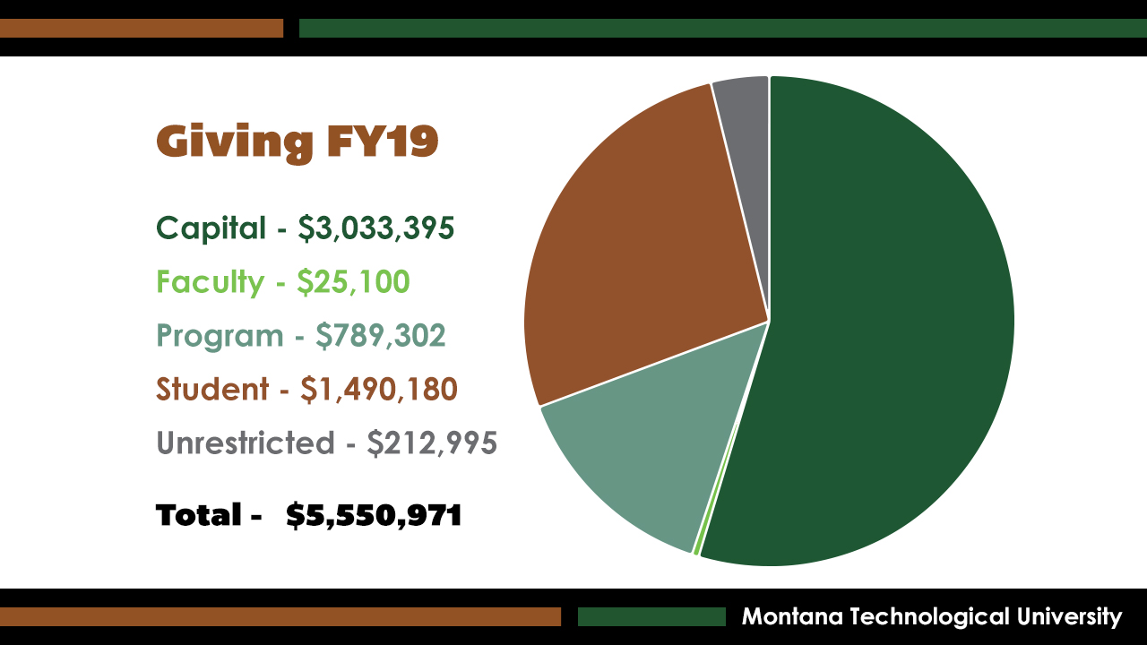

Slide 21
BENCHMARKS
Peer Benchmarks based (data from Raiser’s Edge (RE)) FY18 *
  New Donors 15.21% B+
  Avg. Gift Size $2.16K B
  Retention 45.95% C+
  Recapture 19.81% A+
  Total Raised 5Mm A-
Peer Benchmarks RE FY14 *
  New Donors 7.22% D
  Avg. Gift Size $1.86K C+
  Retention 51.82 C+
  Recapture 13.53% C
  Total Raised 4.3Mm A-
* Raiser’s Edge is our database software. The data consists of donors, and prospective donors it is normalized to like endowment and budget size peers

Slide 22
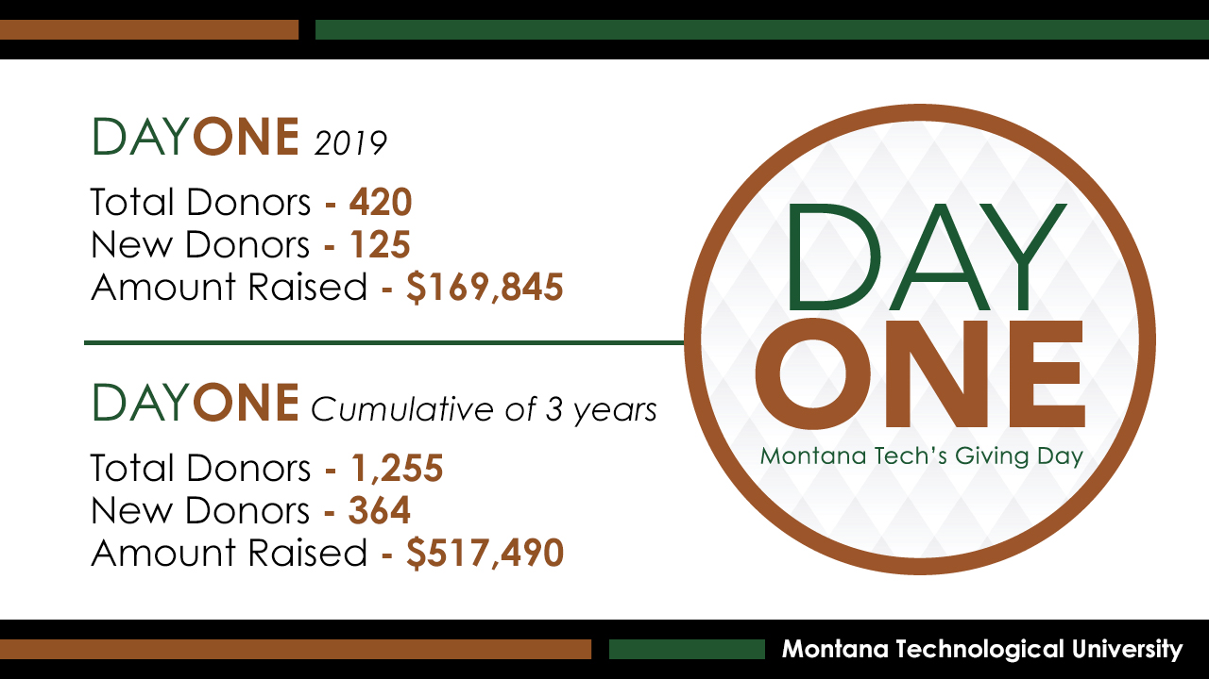

Slide 23


Slide 24
“We’re facing a crisis in enrollment, but its not just an enrollment challenge. Instead, it requires the attention of every member of every university community coming together to think less about our own self-interest and more about the common good of our institutions and society.”
Jon Boeckenstedt, Vice Provost
for Enrollment Management,
Oregon State University
Chronicle of Higher Ed Oct 2019

Slide 25
TEAMS TO HELP DO THIS
Recruitment
Student success
Marketing and communication
Professional training & development
Space planning/campus refresh

Slide 26
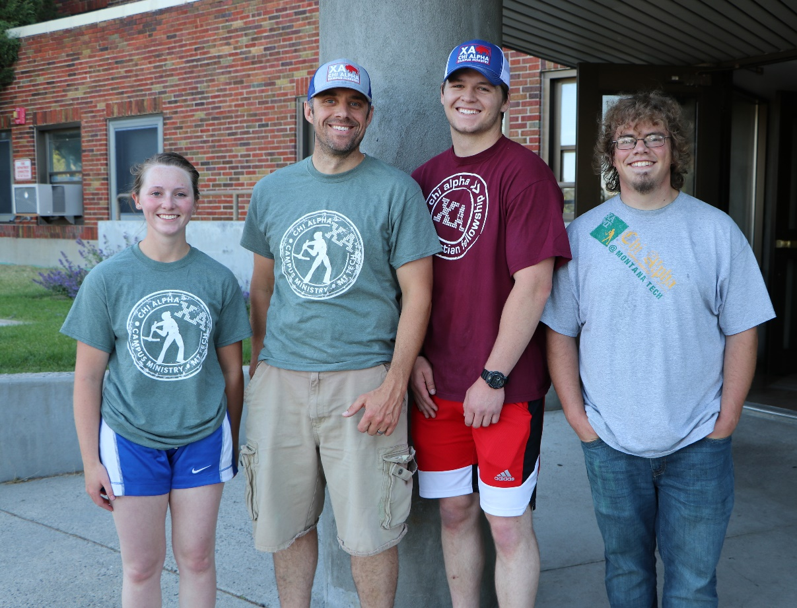
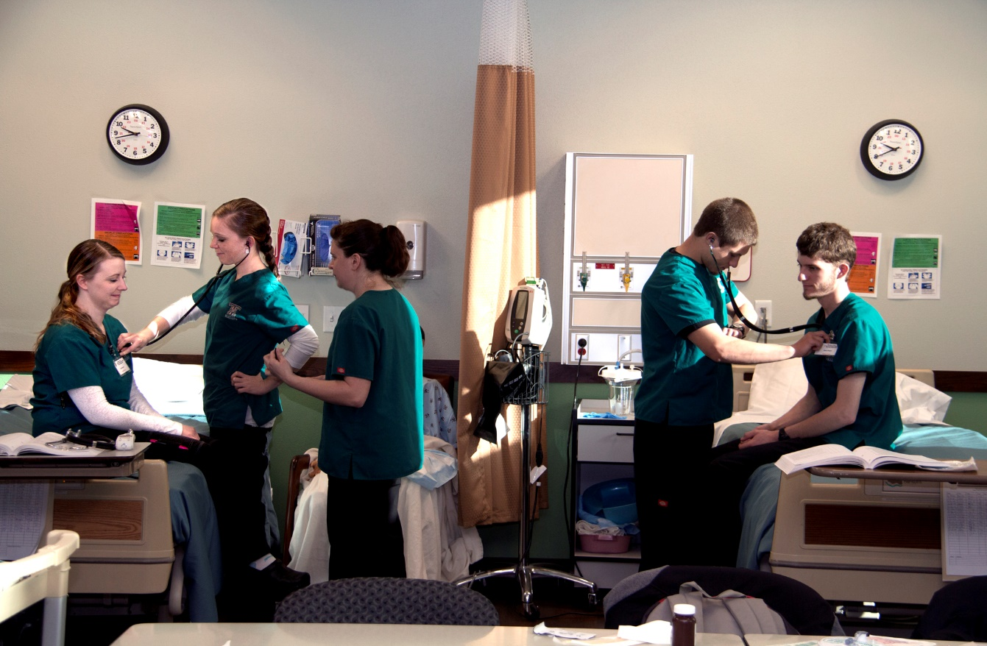
WHAT DOES SUCCESS LOOK LIKE?
Robust enrollment structure & plan in place
Student success/increased retention
High impact marketing/branding campaign developed and deployed
Provost and VC Administration & Finance searches completed
Successful ABET accreditation visit and Northwest Commission mid-cycle review
Approval of two new PhD programs
Funding secured and plans implemented for Nursing Simulation Center
Fiscally sound/balanced budget
Clear and consistent campus communication
Completion of campus space audit with progressive/action driven recommendations

Slide 27

THANK YOU

