Slide 1
September 11, 2020

Slide 2
Celebrating Our Success
In-person instruction
Lowest student debt in Montana
Princeton review
ABET accreditation
First cross-country team/meet TODAY
120 years of Montana Tech
890 years of faculty/staff support

Slide 3
External consultants: Ruffalo Noel Levitz
Launched a comprehensive undergraduate recruitment plan w/data driven goals
Increased new first year Montana residents
Increased new first-year female students, both resident/non-resident
Yield
Evaluated scholarship awarding practices and delivered a revised model for 2021 incoming class
Applied the new model to a True Cost Calculator for perspective student and parent information

Slide 4
ADV Marketing Research
Created new brand portfolio and identity manual including institutional marks
Developed brand communication messaging portfolio
Redesigned website including homepage, undergraduate admissions, and graduate admissions which included new brand messaging

Slide 5
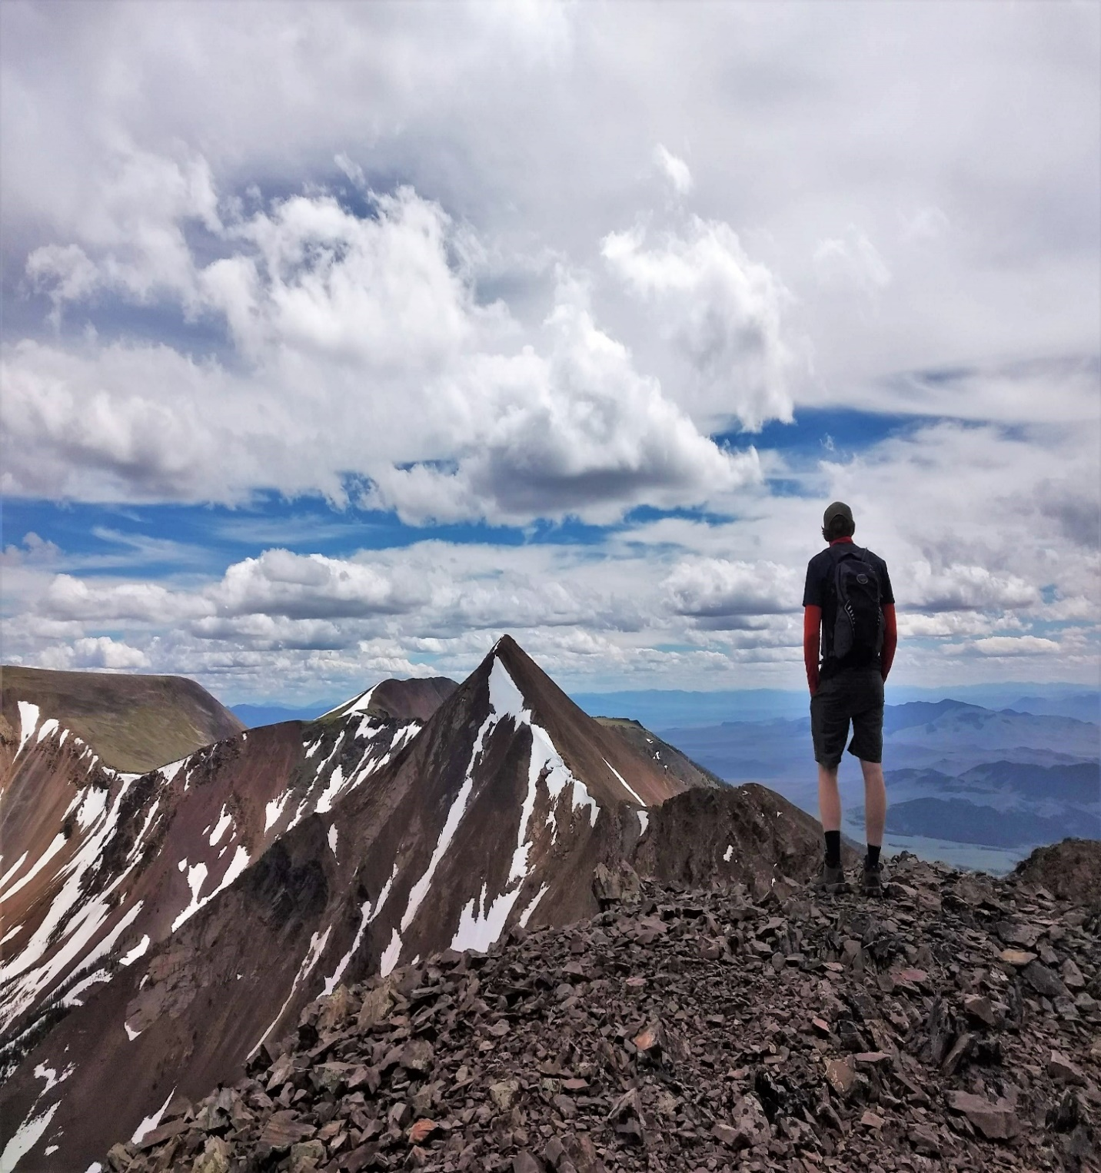
VISION 2020-21
Successfully navigate COVID-19
Recruitment/student success
Telling our story
POSITIONING OURSELVES FOR THE FUTURE

Slide 6
LOOKING AHEAD TO 2020-21
Return to face-to-face instruction and a healthy campus for FY21
New brand launch
New strategic plan with mission, vision, values and goals
Complete campus master plan
Strategic enrollment plan
Highlands College reinvention
Increase transfer student enrollment through enriched 2-year college transfer agreements
Build out of academic advising/student success model
Enhance business processes/applications through technology
Construction complete of nursing simulation center
Renovation of library auditorium complete
Vice Chancellor for Admin/Finance and Vice Chancellor for Research/Dean of the Graduate School searches completed
Deans hired for the College of Letters, Sciences and Professional Studies and Highlands College
Initiate new opportunities for faculty/staff professional development
Auxiliary gym referendum
Long range building plan approval for campus heating system upgrade
Founding class of track & field athletes recruited

Slide 7
Brand and Identity

Slide 8
PROJECT OVERVIEW
Phase 1: Qualitative and Quantitative research
Phase 2: Brand Campaign and Communication Plan
Phase 3: Brand Portfolio and Identity Manual
Phase 4: Reimagined website

Slide 9
BRAND PROMISE
Montana Technological University connects focused students to a network of people, opportunities, and experiences that empower them to change the world.

Slide 10
BRAND PILLARS
A smart investment.
Montana.
A culture of determined doers.
Improve the lives of other through discovery and ingenuity.
Engaged and collaborative faculty and staff cultivate student success.

Slide 11
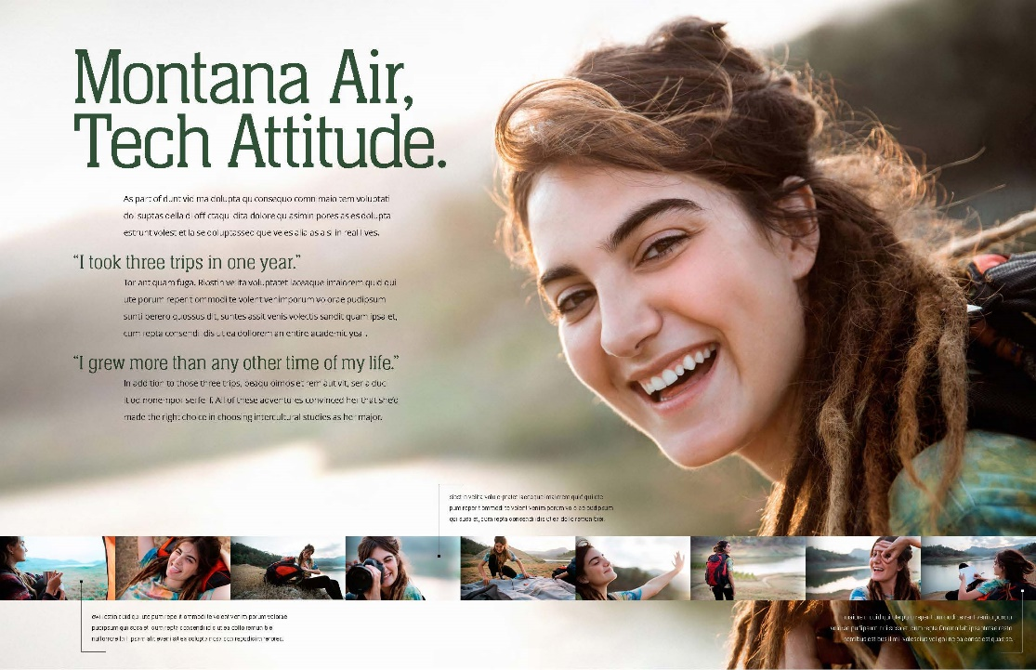
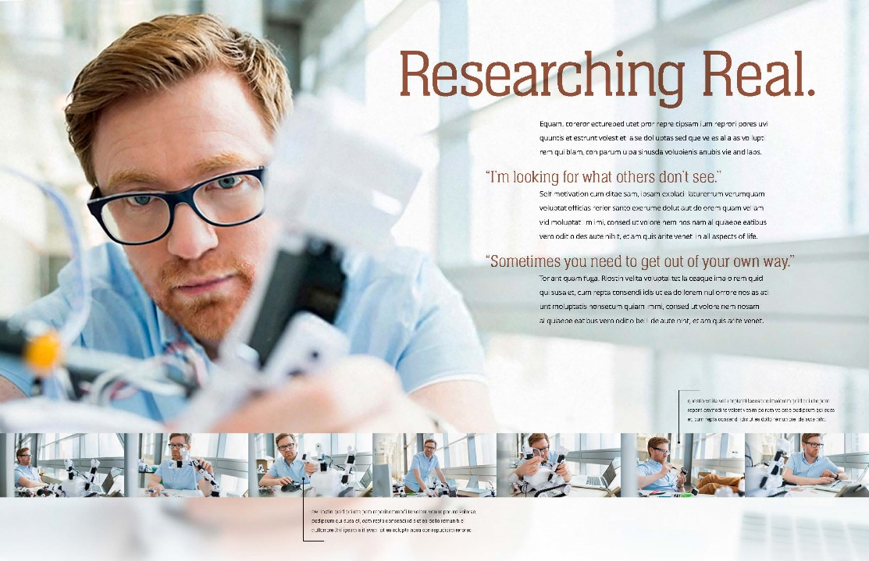
BRINGING MONTANA TRUE TO LIFE

Slide 12
BRINGING MONTANA TRUE TO LIFE

Slide 13
NEW INSTITUTIONAL MARKS

Slide 18
COLLATERAL PACKAGE Business cards, letterhead, envelopes

Slide 19
WHAT’S NEXT
Extend the brand across campus, in the community, and beyond
Brand consistency
Recruit ambassadors

Slide 20
DayOne Montana Tech’s Giving Event
DayOne is only possible because of you…
THANK YOU!
So what is DayOne?
DayOne is a celebration of Montana Technological University’s first day of classes on the 11th of September in 1900.
DayOne is the opportunity to celebrate with our Montana Tech community, share all the good things happening on our campuses, and raise funds in focused areas for our departments, programs, clubs and initiatives.

Slide 21
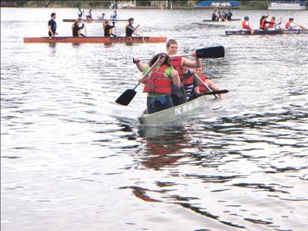
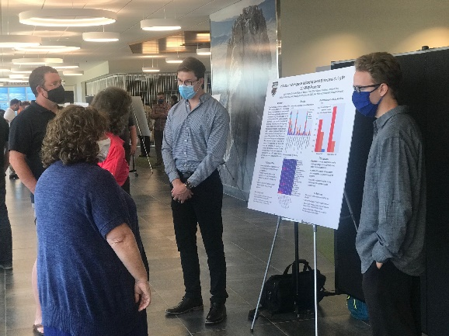
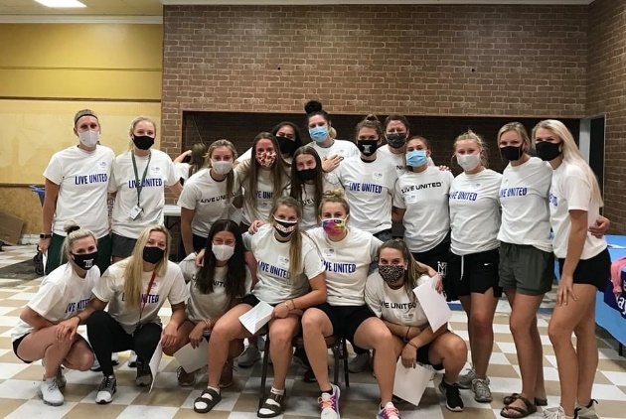
Why is DayOne Important?
The students and programs we serve
It’s beyond giving it’s about ENGAGEMENT
Providing motivated alumni, friends and donors opportunities to support what they love
Advancing as ONE

Slide 22
What are the impacts of DayOne?
Dollars raised - $455,000 from 2017-2019
Total Donors - 1,255 donors from 2017-2019
Total New Donors – 600 from 2017-2019
Programs impacted - 45 projects over the last 4 years
Matched Dollars - $156,000 in matching funds for projects

Slide 23
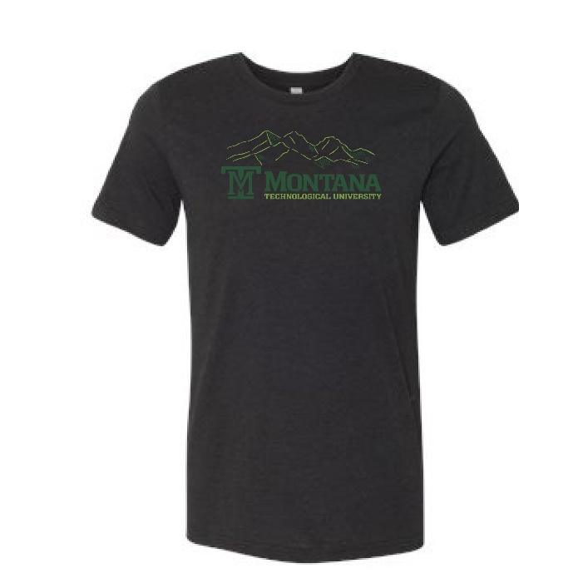
DayOne 2020 and the final push
Donors
Dollars
Matching Opportunities
Departmental Challenge
Ambassador Leaderboard
Giving Incentives
And time left on the clock!

Slide 24
DayOne is just the beginning…
Why growing COMMUNICATION
and ENGAGEMENT
matters.

Slide 25
THANK YOU

